Slide 1
Permutation & Combination

Slide 2
Problem!!!
In how many ways can we arrange five students in a line for a picture?
In how many ways can we select three students from a group of five students to stand in line for a picture?

Slide 3
Permutations
Theorem
Any arrangement of a set of n objects in a given order is called a permutation of the object (taken all at a time).

Slide 4
Permutations
Theorem
Any arrangement of a set of n objects in a given order is called a permutation of the object (taken all at a time).
In how many ways can we arrange three letter A, B, C without repetition?

Slide 5
Permutations
Theorem
Any arrangement of a set of n objects in a given order is called a permutation of the object (taken all at a time).
In how many ways can we arrange three letter A, B, C without repetition?
Corollary
There are n! permutations of n objects (taken all at a time).

Slide 6
r-permutation
Theorem
Any arrangement of any r ≤ n of n objects in a given order is called an “r-permutation” or “a permutation of the r objects taken at a time.”

Slide 7
r-permutation
Theorem
Any arrangement of any r ≤ n of n objects in a given order is called an “r-permutation” or “a permutation of then objects taken r at a time.”
The number of permutations of n objects taken r at a time will be denoted by

Slide 8
r-permutation
In how many ways can we select three students from a group of five students to stand in line for a picture?
In how many ways can we select four students from a group of five students to stand in line for a picture

Slide 9
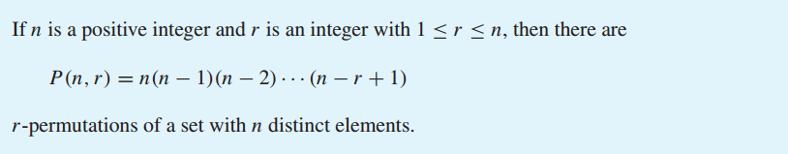
r-permutation
Theorem

Slide 10
P (n, r) = n(n−1)(n−2)···(n−r+1)
Proof
We will use the product rule to prove that this formula is correct. The first element of the permutation can be chosen in n ways because there are n elements in the set. There are n−1 ways to choose the second element of the permutation, because there are n−1 elements left in the set after using the element picked for the first position. Similarly, there are n−2 ways to choose the third element, and so on, until there are exactly n−(r−1)=n−r+1 ways to choose the r^{th} element. Consequently, by the product rule, there are n(n−1)(n−2)···(n−r+1) r-permutations of the set.

Slide 11
r-permutation : Example
Problem: How many ways are there to select a first-prize winner, a second-prize winner, and a third-prize winner from 100 different people who have entered a contest?
Solve: Because it matters which person wins which prize, the number of ways to pick the three prize winners is the number of ordered selections of three elements from a set of 100 elements, that is, the number of 3-permutations of a set of 100 elements. Consequently, the answer is
P(100,3) = 100·99·98 = 970,200.

Slide 12
r-permutation : Example
Problem: Suppose that there are eight runners in a race. The winner receives a gold medal, the second place finisher receives a silver medal, and the third-place finisher receives a bronze medal. How many different ways are there to award these medals, if all possible outcomes of the race can occur and there are no ties?
Solve: The number of different ways to award the medals is the number of 3-permutations of a set with eight elements. Hence, there are
P(8,3) = 8·7·6 = 336 possible ways to award the medals.

Slide 13
r-permutation : Example
Problem: Suppose that a saleswoman has to visit eight different cities. She must begin her trip in a specified city, but she can visit the other seven cities in any order she wishes. How many possible orders can the saleswoman use when visiting these cities?
Solve: The number of possible paths between the cities is the number of permutations of seven elements, because the first city is determined, but the remaining seven can be ordered arbitrarily.
Consequently, there are 7! = 7·6·5 · 4·3·2· 1 = 5040 ways
for the saleswoman to choose her tour

Slide 14
r-permutation : Example
Problem: How many permutations of the letters ABCDEFGH contain the string ABC?
Solve: Because the letters ABC must occur as a block, we can find the answer by finding the number of permutations of six objects, namely, the block ABC and the individual letters D, E, F, G, and H. Because these six objects can occur in any order, there are 6!=720 permutations of the letters ABCDEFGH in which ABC occurs as a block.

Slide 15
r-permutation : Example
Problem: How many ways are there for eight men and five women to stand in a line so that no two women stand next to each other? [Hint: First position the men and then consider possible positions for the women.]
Solve: ?

Slide 16
r-combination
An r-combination of elements of a set is an unordered selection of r elements from the set
An r-combination is simply a subset of the set with r elements
Denote by C(n,r). Note that C(n,r) is also denoted by and is called a binomial coefficient

Slide 17
Example
Let S be the set {1, 2, 3, 4}. Then {1, 3, 4} is a 3-combination from S
We see that C(4,2)=6, as the 2-combination of {a, b, c, d} are 6 subsets {a, b}, {a, c}, {a, d}, {b, c}, {b, d}, and {c, d}

Slide 18
r-combination
The number of r-combinations of a set with n elements, where n is a nonnegative integer and r is an integer with 0≤r≤n equals
Proof: The r-permutations of the set can be obtained by forming the C(n,r) r-combinations and then ordering the elements in each r-permutation which can be done in P(r,r) ways

Slide 19
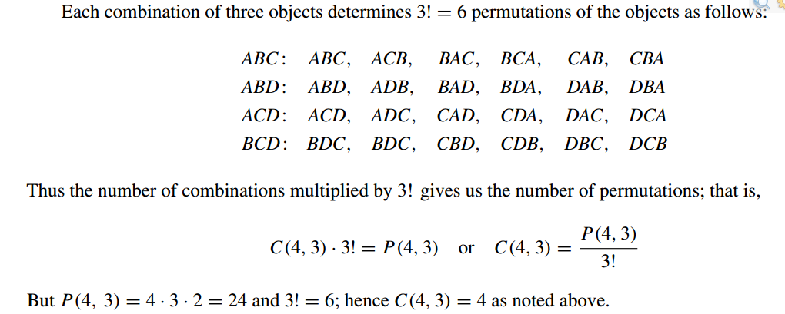
r-combination : Example
Problem: Find the number of combinations of 4 objects A,B,C,D, taken 3 at a time.
Solve:

Slide 20
Combinations example
How many different poker hands are there (5 cards)?
How many ways are there to select five players from a 10-member tennis team to make a trip to a match at another school?
A group of 30 people have been trained as astronauts to go on the first mission to Mars. How many ways are there to select a crew of six people to go on this mission (assuming that all crew members have the same job)?

Slide 21
Combinations example
Problem: Suppose that there are 9 faculty members in the mathematics department and 11 in the computer science department. How many ways are there to select a committee to develop a discrete mathematics course at a school if the committee is to consist of three faculty members from the mathematics department and four from the computer science department?
Solution: By the product rule, the answer is the product of the number of 3-combinations of a set with nine elements and the number of 4-combinations of a set with 11 elements.
By Theorem of r combination, the number of ways to select the committee is
C(9,3) * C(11,4) = 84 * 330= 27,720

Slide 22
Combinations example
Problem: In how many ways can a set of five letters be selected from the English alphabet?
Solve: ?

Slide 23
Permutations vs. Combinations
Both are ways to count the possibilities
The difference between them is whether order matters or not
Consider a poker hand:
A♦, 5♥, 7♣, 10♠, K♠
Is that the same hand as:
K♠, 10♠, 7♣, 5♥, A♦
Does the order the cards are handed out matter?
If yes, then we are dealing with permutations
If no, then we are dealing with combinations

Slide 24
Permutations vs. Combinations Example
Problem: A club has 25 members.
a) How many ways are there to choose four members of the club to serve on an executive committee?
b) How many ways are there to choose a president, vice president, secretary, and treasurer of the club, where no person can hold more than one office?
Solution: ?

Slide 25
Any Questions?

